Slide 1
SESSION Provide identity protection on-premises with Microsoft Advanced Threat Analytics (ATA)
Introduction – Typical Attack Observations
MS ATA how it works and Key Features
MS ATA detects a wide range of suspicious activities
Demo and typical Alerts
Have a response plan
MS ATA Architecture and Sizing / Azure ATP or ATA?

Slide 2
LEARNING OBJECTIVES
01
Describe how Microsoft ATA and its Key Features work
02
List some suspicious activities detected by Microsoft ATA
03
Explain why a response plan is needed
04
Explain Microsoft ATA Architecture and Sizing Requirements
05
Compare Microsoft ATA and Azure ATP

Slide 3
Role of Directory in security
Foundation of security assurances for all information assets in the organization:
Authenticates all user and computer accounts within the Active Directory infrastructure
Centralized delegation and authorization mechanism for many resources.
Modern cyber-attackers actively target directories to get intellectual property and corporate assets

Slide 4
Typical Attack Timeline & Observations
24-48 Hours
Average 8 months →
Initial compromise or entry
vector
Core security compromised
Service outage or data exfiltration
Attack detected


Slide 5
Exploiting Credentials - Attack Sophistication
Active Directory controls access to business assets
Attackers commonly target Active Directory (AD) and IT Admins
Attack operators exploit any weakness
Target information on any device or service

Slide 6
Attacks not detected & Response and Recovery
Current detection tools miss most attacks
You may be under attack
(or compromised)
Response requires advanced expertise and tools
Expensive and challenging to successfully recover

Slide 7
Start with the right assumptions!
Your ARE a TARGET
You CANNOT DEFEND against EVERYTHING
Your infrastructure IS, or WILL BE, COMPROMISED

Slide 8

User and Entity Behavior Analytics - UEBA
Monitors behaviors of users and other entities by using multiple data-sources
Profiles behavior and detects anomalies by using machine learning algorithms
Evaluates the activity of users and other entities to detect advanced attacks

Enterprises successfully use UEBA to detect malicious and abusive behavior that otherwise went unnoticed by existing security monitoring systems, such as SIEM and DLP.


Slide 9
The Anatomy of an Attack
Attacker steals sensitive data
USER
#
ATTACKER
User account is compromised
Attacker attempts lateral movement
Privileged account compromised
Attacker accesses sensitive data
Zero-day / brute-force attack
Anomalous user behavior
Lateral movement attacks
Unfamiliar sign-in location
Escalation of privileges
Account impersonation

Slide 10



Microsoft Advanced Threat Analytics
Behavioral Analytics
Detection of advanced attacks and security risks
Advanced Threat Detection
Microsoft Advanced Threat Analytics brings the behavioral analytics concept to IT and the organization’s users

Slide 11
Key features
Auto updates
Integration to SIEM
Seamless deployment
Updates and upgrades automatically with the latest and greatest attack and anomaly detection capabilities that our research team adds
Analyzes events from SIEM to enrich the attack timeline
Works seamlessly with SIEM
Provides options to forward security alerts to your SIEM or to send emails to specific people
Software Offering that runs on hardware or virtual
Utilizes port mirroring to allow seamless deployment alongside AD, or installed directly on domain controllers
Does not affect existing topology

Slide 12
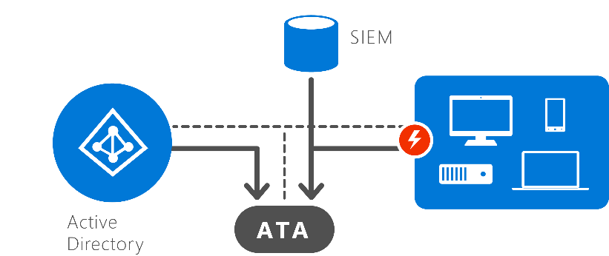
How Microsoft Advanced Threat Analytics Works
1
Collect & Analyze
After installation:
Simple nonintrusive port-mirroring, or deployed directly onto domain controllers
Remains invisible to the attackers
Analyzes all Active Directory network traffic
Collects relevant events from SIEM and information from Active Directory (titles, group membership and more).

Slide 13
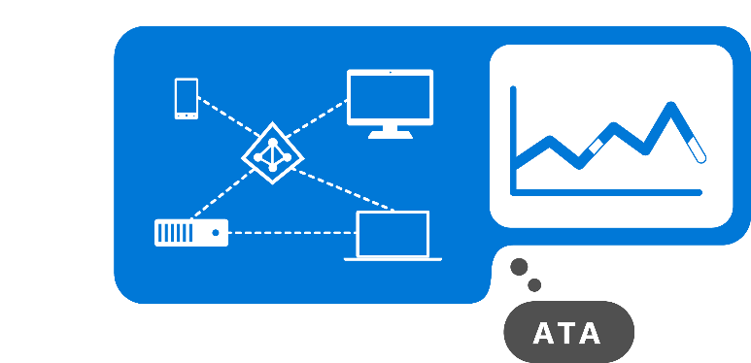
How Microsoft Advanced Threat Analytics Works
2
Learn
Microsoft Advanced Threat Analytics:
Automatically starts learning and profiling entity behavior
Identifies normal behavior for entities
Learns continuously to update the activities of the users, devices, and resources
What is an entity?
An entity represents users, devices, or resources

Slide 14
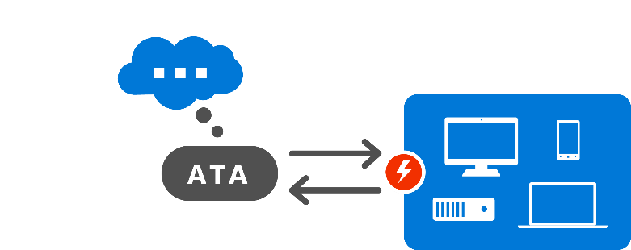
How Microsoft Advanced Threat Analytics Works
3
Detect
Microsoft Advanced Threat Analytics:
Looks for abnormal behavior and identifies suspicious activities
Only raises red flags if abnormal activities are contextually aggregated
Uses world-class security research to detect security risks and attacks in near real-time based on attackers Tactics, Techniques and Procedures
ATA not only compares the entity’s behavior to its own, but also to the behavior of other entities in the environment

Slide 15

How Microsoft Advanced Threat Analytics Works
4
Alert
ATA reports all suspicious activities on a simple, functional, usable attack timeline
ATA identifies
Who?
What?
When?
How?
For each suspicious activity, ATA provides recommendations for the investigation and remediation

Slide 16


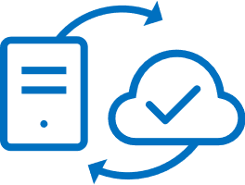
ATA detects a wide range of suspicious activities
Abnormal authentication requests
Abnormal resource access
Pass-the-Ticket
Pass-the-Hash
Overpass-the-Hash
Malicious service creation
Skeleton key malware
Golden ticket
Remote execution
Malicious replication requests
Abnormal Modification of Sensitive Groups
Abnormal resource access
Account enumeration
Net Session enumeration
DNS enumeration
SAM-R Enumeration
Compromised Credential
Privilege
Escalation
!
!
!
Abnormal working hours
Brute force using NTLM, Kerberos, or LDAP
Sensitive accounts exposed in plain text authentication
Service accounts exposed in plain text authentication
Honey Token account suspicious activities
Unusual protocol implementation
Malicious Data Protection Private Information (DPAPI) Request
Abnormal VPN
Reconnaissance
Lateral Movement
MS14-068 exploit (Forged PAC)
MS11-013 exploit (Silver PAC)
Domain
Dominance

Slide 17
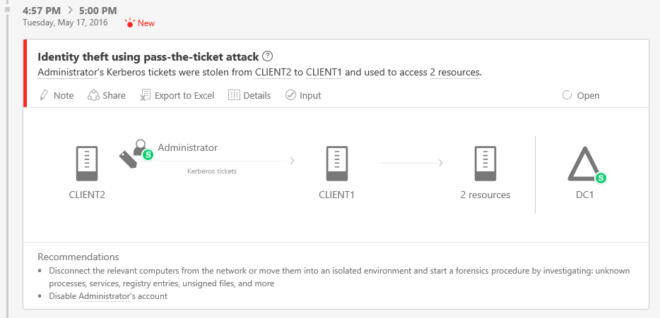
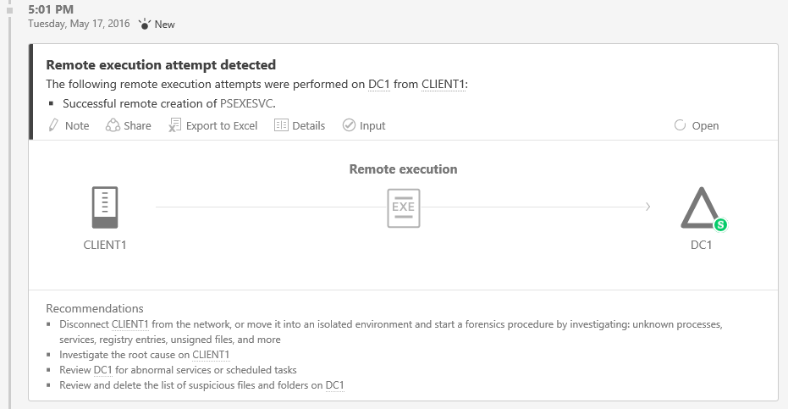
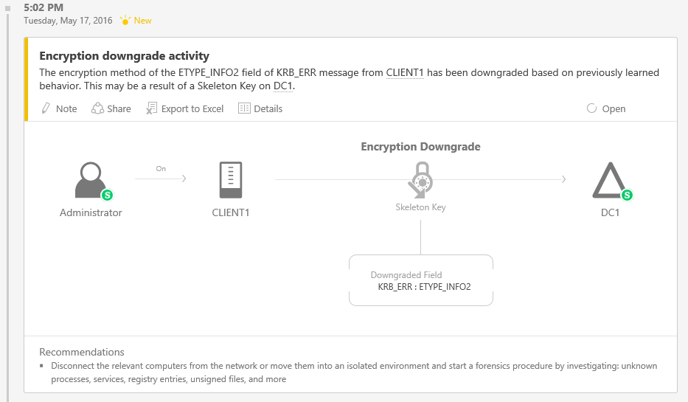
What happens when ATA finds a compromise?
The attacker remotely executed malware on your DC
Someone stole your domain administrator credentials
DEMO
The attacker now has a Skeleton Key – No More Stealing Credentials

Slide 18
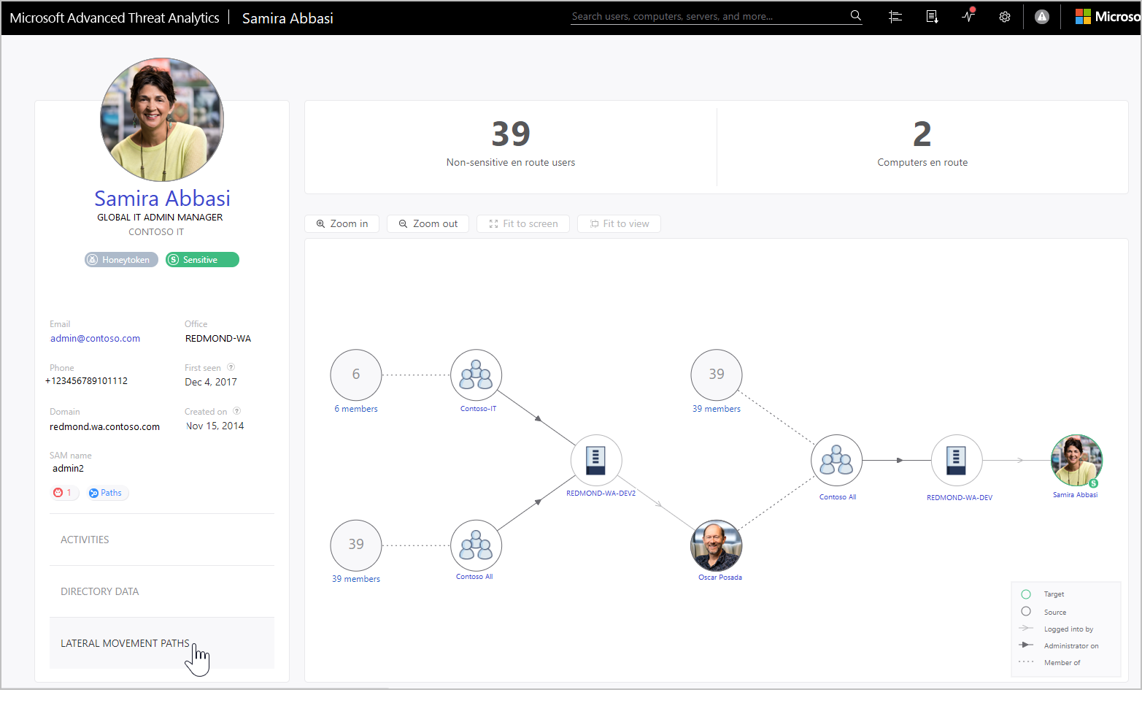
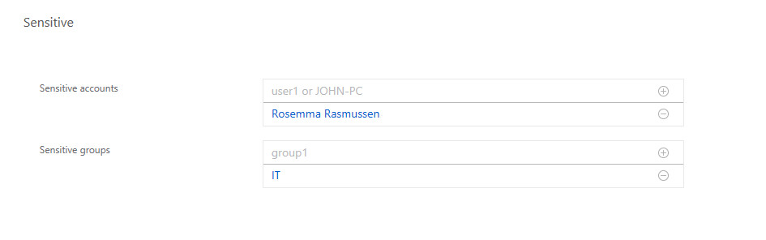
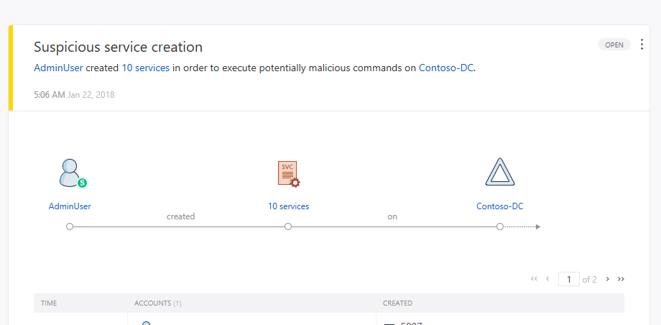
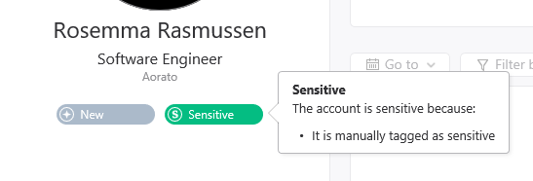
Advanced Threat Analytics (ATA) additional features
Lateral Movement Graph *
Detailed Activity timeline for investigation *
Manually tagging of sensitive entities *
New detection for suspicious service creation*
….
* Also available in Azure ATP

Slide 19
Why is a response plan needed?
If you assume compromise, you assume Microsoft Advanced Threat Analytics (ATA) will find something
If you do not have a response
plan, what do you feel could,
would, or will happen?
A well-established response
plan will prepare you to
address any findings in a
positive manner
Identifying the severity of the incident
Quickly understanding the risk to the organization
Identification of the correct people to investigate, resolve and report on the issue
An agreed upon way to navigate organizational structures
A structured process for communicating to internal and external audiences

Slide 20






ATA Architecture
ATA Lightweight
Gateway
Port mirroring
Domain
Controller
Domain
Controller
Windows Event Forwarding
ATA Gateway
Parsed network traffic from DCs
SIEM
Events
Alerts notifications to SIEM
Access to console
ATA Center
Alert notifications

Slide 21
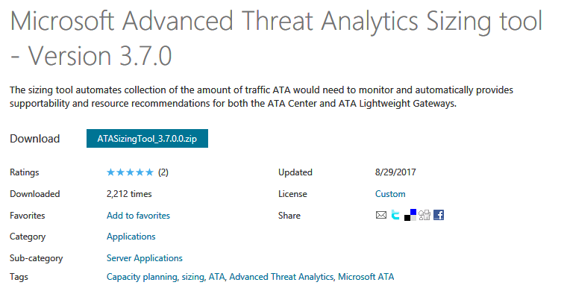
ATA Sizing Tool
https://aka.ms/atasizingtool
Run for 24 hours (default)
Gathers DC performance data packets/sec
ATA Center and Gateway sizing recommendations

Slide 22



Azure ATP Architecture
Port mirroring
Azure ATP Sensor
Domain
Controller
Domain
Controller
Windows Event Forwarding
Azure ATP standalone sensor
Parsed network traffic from DCs
Events
SIEM
Alerts notifications to SIEM
Azure Advanced Threat Protection
Access to console
Alert notifications
Windows Defender ATP

Slide 23
Azure ATP or ATA?
 | Azure ATP | ATA
Environment coverage | On-premises + Cloud data sources | Only on-premises
Data Storage | Sent to Azure | Stays on on-premises
Deployment | Azure Cloud Service New Sensor | ATA Center Gateway
DC agent | Sensor: Up to ~50K pps* | LWGW: Up to 10K pps
Licensing | EMS E5 | EMS E3
Update cadence/Release Date | GA - Q1 CY18 (Weekly Updates) | V1.9 GA – H1 CY18

Slide 24
Resources
Azure ATP Tech Community: http://aka.ms/azureatpcommunity
ATA SA Simulation Playbook: http://aka.ms/ataplaybook
Suspicious Activity Guide: https://aka.ms/atasaguidedocs

Slide 25
Microsoft Enterprise Mobility + Security (EMS)
Identity and access management
Mobile device & app management
Information
protection
Threat protection
Azure Active Directory Premium
Microsoft Intune
Azure Information Protection
Microsoft Cloud App Security
Microsoft Advanced Threat Analytics

